Slide 1
Experience API (xAPI) and Serious Games: the xAPI-SG Profile
e-UCM Research Group
www.e-ucm.es
Iván Martínez Ortíz, Baltasar Fernández Manjón, Manuel Freire Morán, Cristina Alonso Fernández, Iván José Pérez Colado, Antonio Calvo Morata, Víctor Manuel Pérez Colado

Slide 2
Experience API (xAPI)
Experience API (xAPI) is a specification to collect data about the actions of a person in a learning environment. This standard was created by a community lead by ADL.
Any learning action or activity can be traced using xAPI. Traces reported in xAPI are called statements and they include:
an actor: who performed the action
a verb: the action performed
an object: the target of the action
xAPI statements may also include additional fields such as the timestamp of the action or its results.

Slide 3
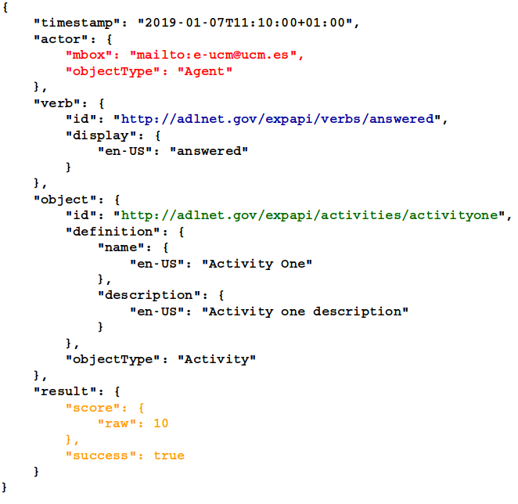
Experience API (xAPI)
Sample xAPI trace:
actor verb: answered object: activityone
result: score=10 and success=true
xAPI trace creator:
https://adlnet.github.io/xapi-lab/

Slide 4
Serious Games and Learning Analytics
Serious Games are games with purposes beyond entertainment (teaching, changing attitudes or behaviours, raising awareness of an issue).
Learning Analytics is the field that aims to track, collect, analyze and report data about learners and their contexts, with the goal to improve the learning process.
Learning Analytics can also be applied to Serious Games, collecting data from in-game interactions and reporting useful information about players. This discipline is called Game Learning Analytics (GLA).
GLA

Slide 5
Game Learning Analytics
What data is to be collected from the game and how it relates to learning goals
Which specific statements (e.g. in xAPI format) are to be tracked from the game containing that information
How the statements collected are to be analyzed and what information is to be reported and/or visualized

Slide 6
Experience API for Serious Games: xAPI-SG Profile
xAPI allows the implementation of profiles for particular contexts: a xAPI profile defines a vocabulary, extensions, statements templates and patterns for that specific domain.
The e-UCM Research Group in collaboration with ADL created the Experience API for Serious Games Profile (xAPI-SG), a xAPI profile for the specific domain of Serious Games.
The xAPI-SG Profile defines a set of verbs, activity types and extensions, that are commonly needed in the context of serious games.
https://adlnet.gov/news/a-serious-games-profile-for-xapi
https://xapi.e-ucm.es/vocab/seriousgames

Slide 7
xAPI-SG Profile
The xAPI-SG Profile is the result of the implementation of an interactions model for Serious Games in xAPI.
The types of interactions that can be performed in a Serious Game, and are included in the profile, can be grouped based on the type of interactions and game objects that the interaction is performed over.
The following slides present some of these common interactions and game objects related with them, with example xAPI-SG statements.
completables
accessibles
alternatives
GameObjects

Slide 8
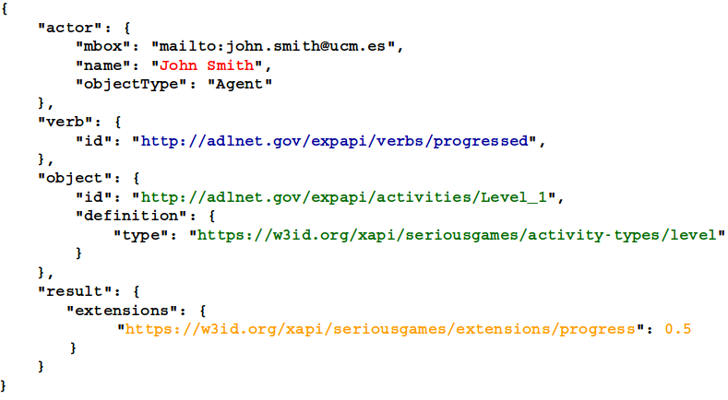
xAPI-SG: Completables
A completable is something a player can start, progress and complete in a game, maybe several times.
Verbs: initialized, progressed, completed
Types: game, session, level, quest, stage, combat, storynode, race, completable
John Smith progressed on Level 1
0.5

Slide 9
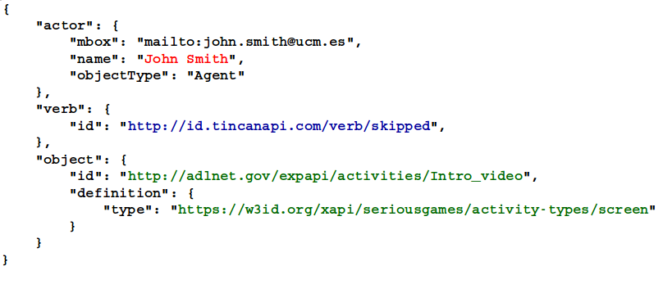
xAPI-SG: Accessibles
An accessible is is a virtual space inside the game world a player can access or skip once or multiple times.
Verbs: accessed, skipped
Types: screen, area, zone, cutscene, accessible
John Smith skipped Intro video

Slide 10
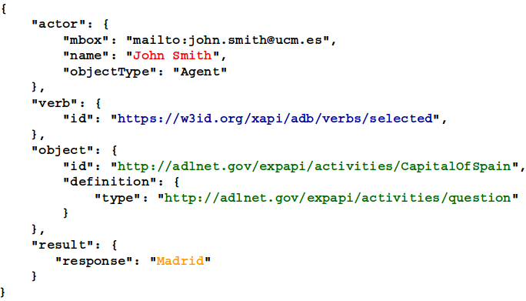
xAPI-SG: Alternatives
An alternative is a decision the player faces in the game, where the player has to choose only one option among several. Options can be unlocked.
Verbs: selected, unlocked
Types: question, menu, dialog, path, arena, alternative
John Smith selected in Capital of Spain
Madrid

Slide 11
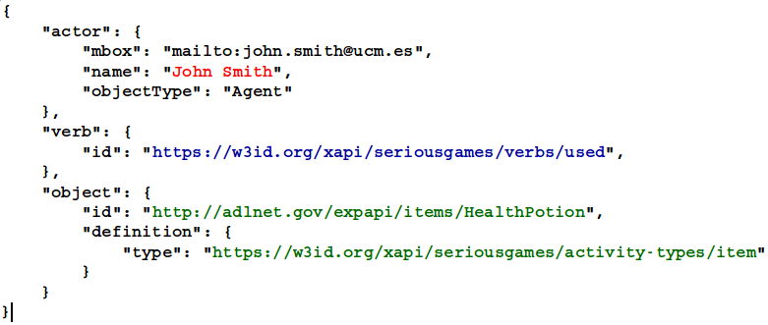
xAPI-SG: GameObjects
A GameObject is a game element the player can interact with.
Verbs: interacted, used
Types: enemy, npc, item, gameobject
John Smith used Health potion

Slide 12
xAPI-SG Profile: Extensions
health: Used to represent the remaining health of the player (e.g., number of hearts, energy bar).
position: Used to represent the current position of the player inside the game world.
progress: Indicates the progress in a completable.
https://xapi.e-ucm.es/vocab/seriousgames

Slide 13
xAPI-SG: Custom interactions
The set of verbs and activity types defined in the xAPI-SG Profile allows to track data from any serious game without any information of the game (game-independent). The Profile aims to cover most of the possible interactions required in the particular context of SGs, so it can be used for most SGs.
However, there may be some situations where the Profile does not fit the specific requirements or characteristics of the serious game we want to collect data from. For these scenarios, game-dependent vocabulary can be defined to complement the xAPI-SG Profile, including new verbs, activity types or extensions, as needed.
For example, if tracking chat logs we could define a new target “chat message” with the verb “send”.

Slide 14
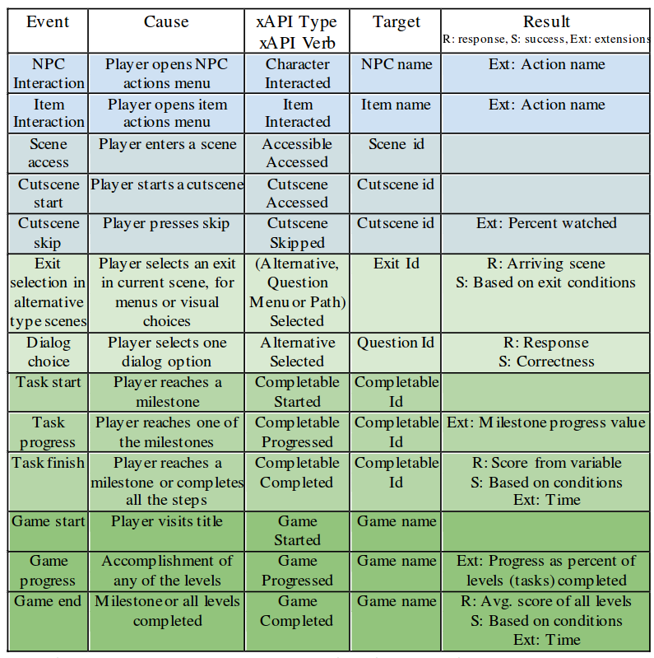
uAdventure Automatic xAPI-SG tracking
targets
accessibles
alternatives
completables

Slide 15
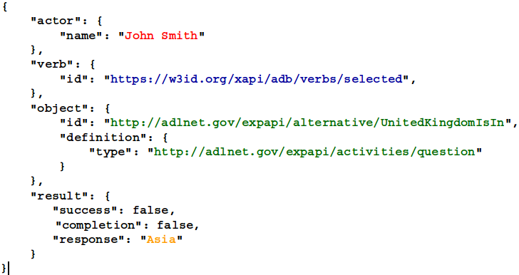
Example xAPI-SG tracking
Countrix Q&A geography game to test tracking of xAPI-SG statements. Example xAPI-SG trace of selecting a response in a question.

Slide 16
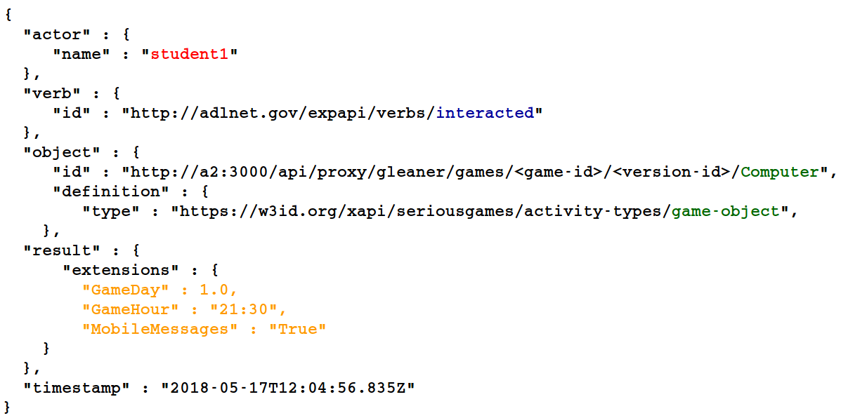
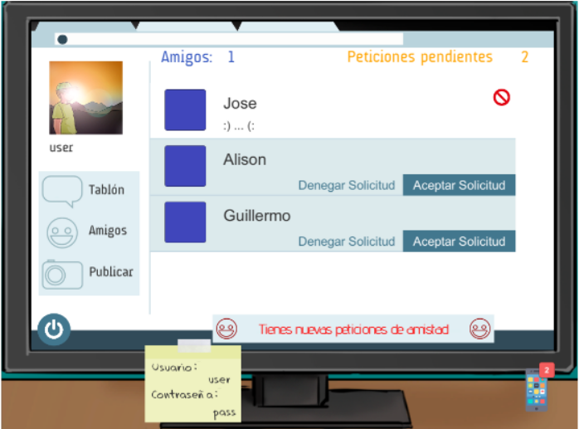
Example xAPI-SG tracking
Conectado game to raise awareness about bullying and cyberbullying. Example xAPI-SG trace of interacting with a game object.

Slide 17
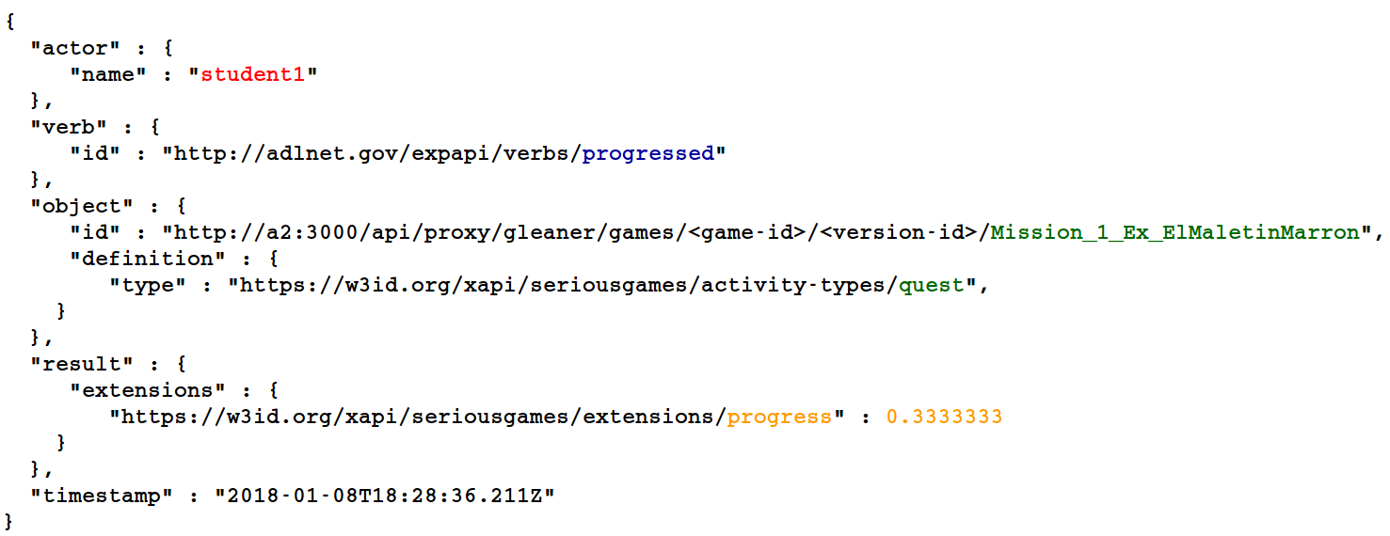
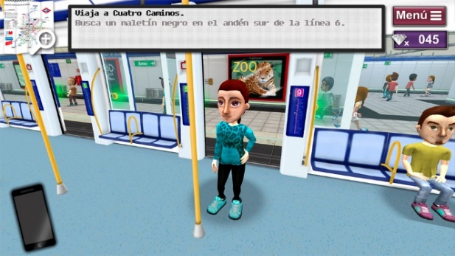
Example xAPI-SG tracking
DownTown game to train students with intellectual disabilities how to move around the Madrid Subway. Example xAPI-SG trace of progressing in a quest.

Slide 18
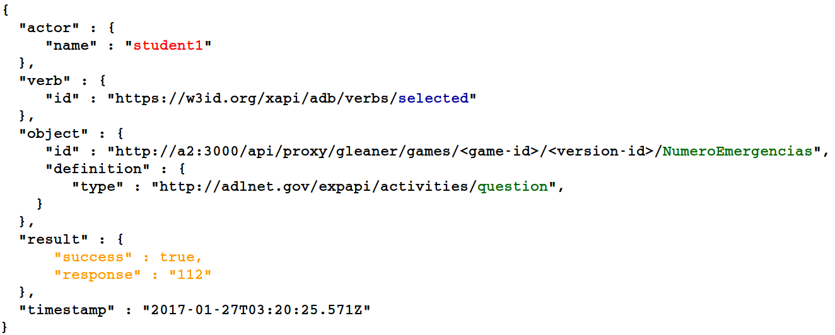
Example xAPI-SG tracking
First Aid Game to teach first aid maneuvers. Example xAPI-SG trace of selecting a response in a question.

Slide 19
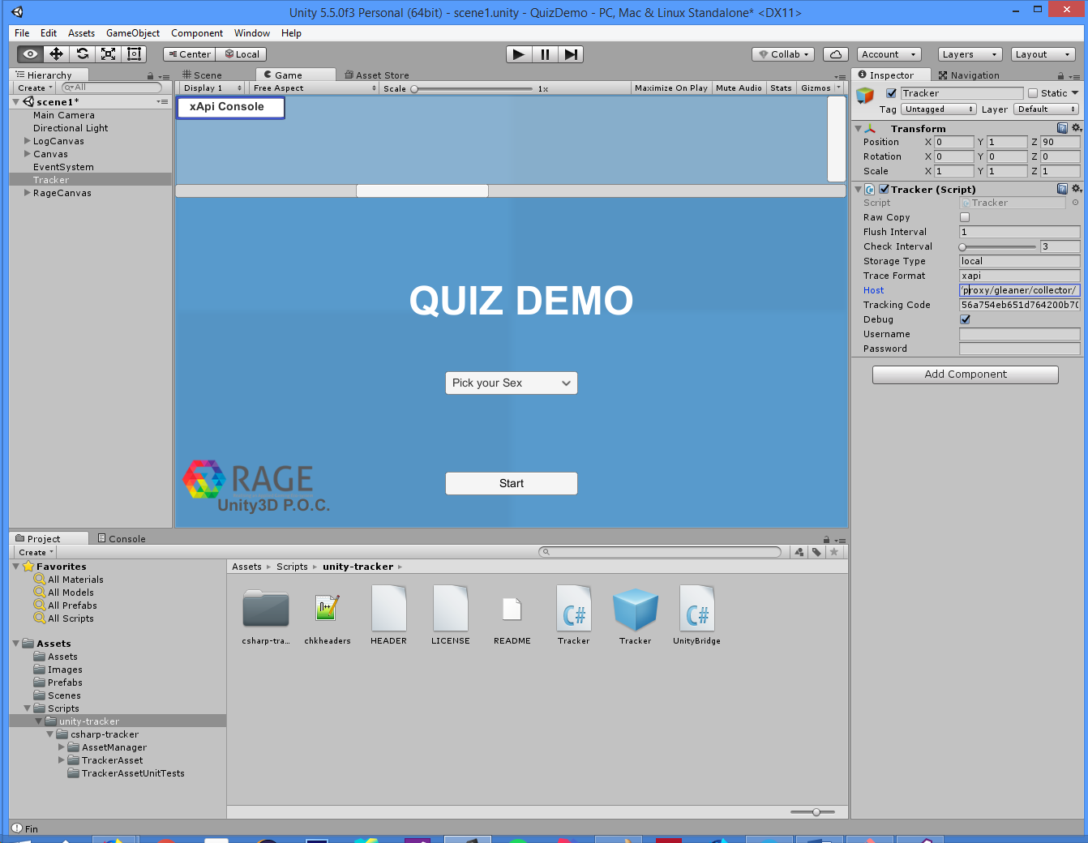
Using Unity Tracker: Proof of Concept
git clone --recursive https://github.com/e-ucm/QuizDemo

Slide 20
Using Unity Tracker: Proof of Concept
Raw Copy: Create a file in the client with all the traces in csv format.
Flush Interval: Time (in seconds) between two shipments of traces.
Storage Type: “local” to only save data into the client or “net” to send data to the server.
Trace Format: How format send the traces (“json”, “xapi” or “csv”).
Tracking Code: Code to match the client to the server and send data to a specific activity.
Debug: Show debug info.
Username and password (optional): anonymous if empty.
Tracker.cs

Slide 21
Using Unity Tracker: Proof of Concept
The tracker.cs script is a custom mode to configure TrackerAsset.cs.
The users of tracker can configure their own script to initialize the tracker and to flush the data traces.
→ The “xApi Console” show the sent data.

Slide 22
Using Unity Tracker: Proof of Concept
verb: selected
object.definition: alternative
object.id: “Selected sex”
result.response: sex.text
verb: selected
object.definition: alternative
object.id: “Start game”
result.response: “Start”
verb: accessed
object.definition: accessible
object.id: nextScene
verb: selected
object.definition: alternative
object.id: questionId
result.response: optionId
Sending data (examples):

Slide 23
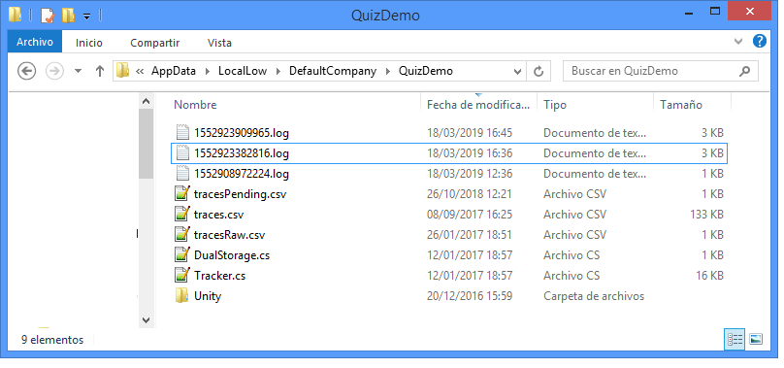
Using Unity Tracker: Proof of Concept
In the QuizDemo case the log and raw data is saved into:
%userprofile%\AppData\LocalLow\DefaultCompany\QuizDemo

Slide 24
References
xAPI-SG Profile:
Ángel Serrano-Laguna, Iván Martínez-Ortiz, Jason Haag, Damon Regan, Andy Johnson, Baltasar Fernández-Manjón (2017): Applying standards to systematize learning analytics in serious games. Computer Standards & Interfaces 50 (2017) 116–123, http://dx.doi.org/10.1016/j.csi.2016.09.014
xAPI-SG profile: https://xapi.e-ucm.es/vocab/seriousgames
GitHub page: https://github.com/e-ucm/rage-analytics/wiki/xAPI-SG-Profile
ADL Profile page: https://adlnet.gov/news/a-serious-games-profile-for-xapi
Game Learning Analytics:
Manuel Freire, Ángel Serrano-Laguna, Borja Manero, Iván Martínez-Ortiz, Pablo Moreno-Ger, Baltasar Fernández-Manjón (2016): Game Learning Analytics: Learning Analytics for Serious Games. In Learning, Design, and Technology (pp. 1–29). Cham: Springer International Publishing. http://doi.org/10.1007/978-3-319-17727-4_21-1.
uAdventure:
https://github.com/e-ucm/uAdventure

